Slide 1
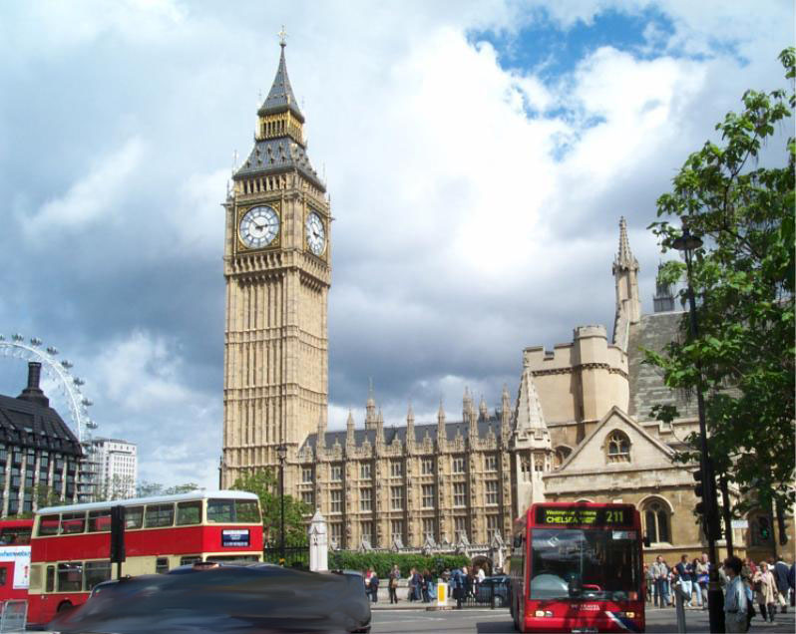



















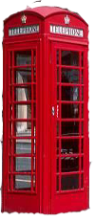
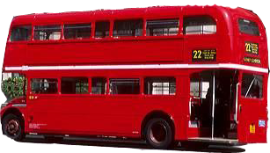

Slide 2



PERIOD 43
UNIT 7 – OUR NEIGHBORHOOD
LESSON 4: READ

Slide 3


MEMORY GAME
Name facilities you see in the clip?

Slide 4
MEMORY GAME
jewery store
cosmestic store
health care center
supermarket
fastfood store
restaurant
shoes store
watch store
children’s play area
clothing store

Slide 5
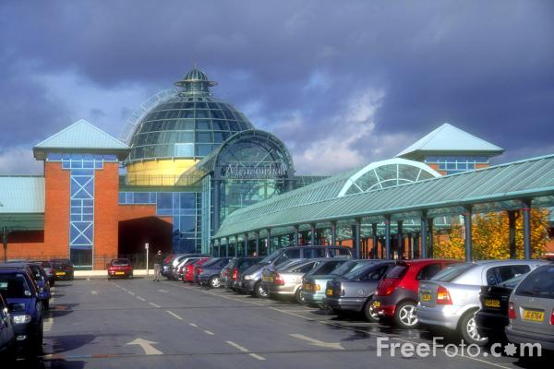
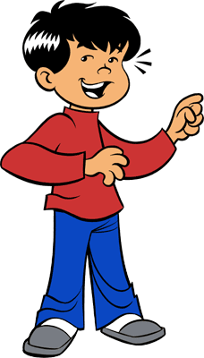
Hi, My name is Nam. A new shopping center is opening in my neighborhood today.

Slide 6

PRE - QUESTIONS
1. What is special about the new shopping center?
2. What facilities are availabe in the shopping center?

Slide 7

PRE - QUESTIONS
1. All stores are under one roof.
2. There are 50 air conditioned specialty stores, 4 movie theaters, 10 restaurants and a children’s play area.

Slide 8
MATCHING THE WORDS OR PHRASES
A | B
1. shopping mall
a. get one’s job
b. be interested in something with a feeling worry because it is important or affects you
2. to take one’s business
c. shopping center where the stores are under one roof
3. to offer a wider selection
4. to be concerned about
d. someone who lives at a particular place for a long period
5. a resident
e. provide a lot of choice

Slide 9

TRUE AND FALSE STATEMENTS
1. The mall is open six days a week
2. There are more than 50 stores in the mall.
3. Everyone in the neighborhood is pleased about the new mall.
4. It will be more comfortable to shop in the mall than in the present shopping stores.
5. Some of the stores on Tran Phu street may have to close.
6. The stores in the mall will offer a wider selection of products, some at lower prices.

Slide 10









PICKING FLOWERS

Slide 11
DICUSSION
What do people in Nam’s neighborhood think about the new shopping mall? Add some more your own ideas.

Slide 12

Role play
Situation: You are residents and store owners in Tran Phu neighborhood. You will attend the community meeting to discuss about it.

Slide 13
CONSOLIDATION
What is the passage about?
Can you summarize the passage in 4 or 5 sentences.

Slide 14

BE A WISE SHOPPER AND ENJOY YOUR SHOPPING MOMENTS

Slide 15

Learn by heart the new words.
Write an essay about the convenience or inconvenience of a new shopping mall.
Prepare Writing .

Slide 16
Best wishes to all of you.
Good bye. See you soon.

Slide 17
BACK
1. The mall is open six days a week
- Is it true or false?
Please correct if it is false
- Where do you find it?
False.
It is open daily(7 days a week).
In the advertisement

Slide 18
BACK
2. There are more than 50 stores in the mall.
- Is it true or false?
Please correct if it is false.
False. There are 50 stores.

Slide 19
BACK
3. Everyone in the neighborhood
is pleased about the new mall.
- Is it true or false?
Please correct if it is false
False
Not everyone is pleased.

Slide 20
BACK
4. It will be more comfortable to shop in the mall than in the present shopping stores.
- Is it true or false?
Please correct if it is false
True

Slide 21
BACK
5. Some of the stores on Tran Phu street may have to close.
- Is it true or false?
Please correct if it is false
- Give the reason.
True.
Because the store owners think the shopping mall will take their customers.

Slide 22
BACK
6. The stores in the mall will offer a wider selection of products, some at lower prices.
- Is it true or false?
Please correct if it is false
True

Slide 23
BACK
PICKING FLOWERS
LUCKY FLOWER
You will give a flower

Slide 24
READ AND UNDERLINE THESE WORDS AND PHRASES
A new shopping mall in opening in Nam's neighborhood today. It is very different from the present shopping area. All the shops are under one roof. That will be very convenient, especially during the hot and humid summer months. Customers will shop in comfort and won't notice the weather.
Some people in the neighborhood, however, are not happy about the changes. The owners of the small stores on Tran Phu Street think the mall will take their business. Some of the goods in the new stores will be the same as the ones in the small shops, but the stores in the mall will offer a wider selection of products, some at cheaper prices.
The residents are store owners have been concern about the new mall for a few months. They have organized a community meeting in order to discuss the situation.

